Slide 1
Deadlocks
Chapter 6
6.1. Resource
6.2. Introduction to deadlocks
6.3. The ostrich algorithm
6.4. Deadlock detection and recovery
6.5. Deadlock avoidance
6.6. Deadlock prevention
6.7. Other issues

Slide 2
Resources
Examples of computer resources
  printers
  tape drives
  tables
Processes need access to resources in reasonable order
Suppose a process holds resource A and requests resource B
  at same time another process holds B and requests A
  both are blocked and remain so

Slide 3
Resources (1)
Deadlocks occur when …
  processes are granted exclusive access to devices
  we refer to these devices generally as resources
Preemptable resources
  can be taken away from a process with no ill effects
Nonpreemptable resources
  will cause the process to fail if taken away
לא ניתן לחילוץ

Slide 4
Resources (2)
Sequence of events required to use a resource
  request the resource
  use the resource
  release the resource
Must wait if request is denied
  requesting process may be blocked
  may fail with error code

Slide 5
Introduction to Deadlocks
Formal definition :
A set of processes is deadlocked if each process in the set is waiting for an event that only another process in the set can cause
Usually the event is release of a currently held resource
None of the processes can …
  Run הוא חסום בבלוק (ישן) לא מתקדם
  release resources
  be awakened

Slide 6
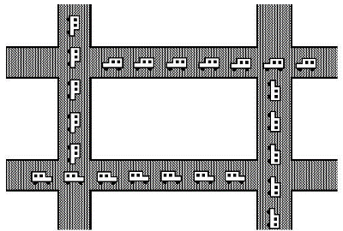
מסקנות
האם תהליך יחיד יכול להיות בקיפאון?
האם בהמתנה פעילה נגדיר קיפאון?
אם תהליך מבקש משאב וכעבור זמן (time out) מקבל כישלון האם זה נחשב קיפאון?
האם כל אחד מהתהליכים במעגל חייב להחזיק ולהמתין?
מדוע fork מחזירה כישלון ולא המתנה
מה ההסתברות לצאת מקיפאון
מכירת בית עם משכנתא

Slide 7
מסקנות
האם תהליך יחיד יכול להיות בקיפאון? לא
האם בהמתנה פעילה נגדיר קיפאון? לא
אם אחרי X זמן יש time out ? אין קפאון
האם כל אחד מהתהליכים במעגל חייב להחזיק ולהמתין? כן.
מדוע fork מחזירה כישלון ולא המתנה? למנוע קיפאון
מה ההסתברות לצאת מקיפאון? 0%
מכירת בית עם משכנתא . איך נפתר? ספולר (מנהל)

Slide 8
Four Conditions for Deadlock
Mutual exclusion condition משאב אקסלובי -
  each resource assigned to 1 process or is available
Hold and wait condition
  process holding resources can request additional
No preemption condition
  previously granted resources cannot forcibly taken away
Circular wait condition
  must be a circular chain of 2 or more processes
  each is waiting for resource held by next member of the chain

Slide 9
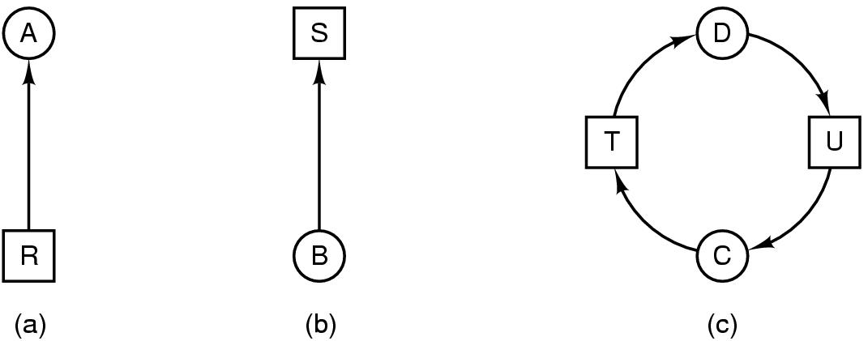
Deadlock Modeling (2)
Modeled with directed graphs
  resource R assigned to process A
  process B is requesting/waiting for resource S
  process C and D are in deadlock over resources T and U
hold
wait

Slide 10
Deadlock Modeling (3)
Strategies for dealing with Deadlocks
  just ignore the problem altogether
  detection and recovery
  dynamic avoidance
    careful resource allocation
  prevention
    negating one of the four necessary conditions

Slide 11
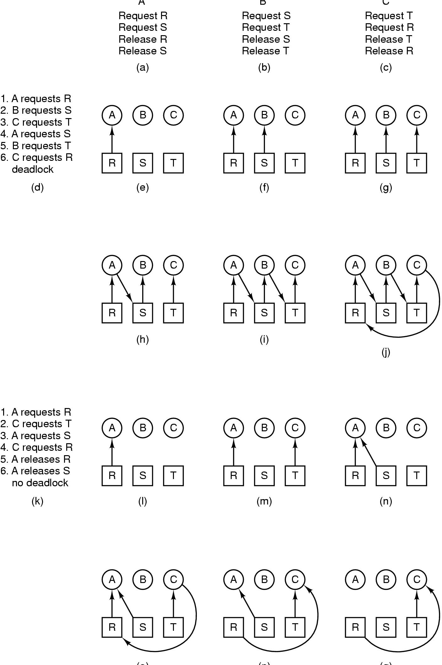
Deadlock Modeling (4)
האם התוכניות יובילו לקיפאון?
תשובה: תלוי בתזמון.
מסקנה: מקבליות -> גוררת סכנת קיפאון
A B C
How deadlock occurs

Slide 12
Deadlock Modeling (4)
A B C
How deadlock occurs

Slide 13
Deadlock Modeling (5)
(o) (p) (q)
How deadlock can be avoided

Slide 14
The Ostrich Algorithm
Pretend there is no problem
Reasonable if
  deadlocks occur very rarely
  cost of prevention is high
UNIX and Windows takes this approach
It is a trade off between
  convenience
  correctness

Slide 15
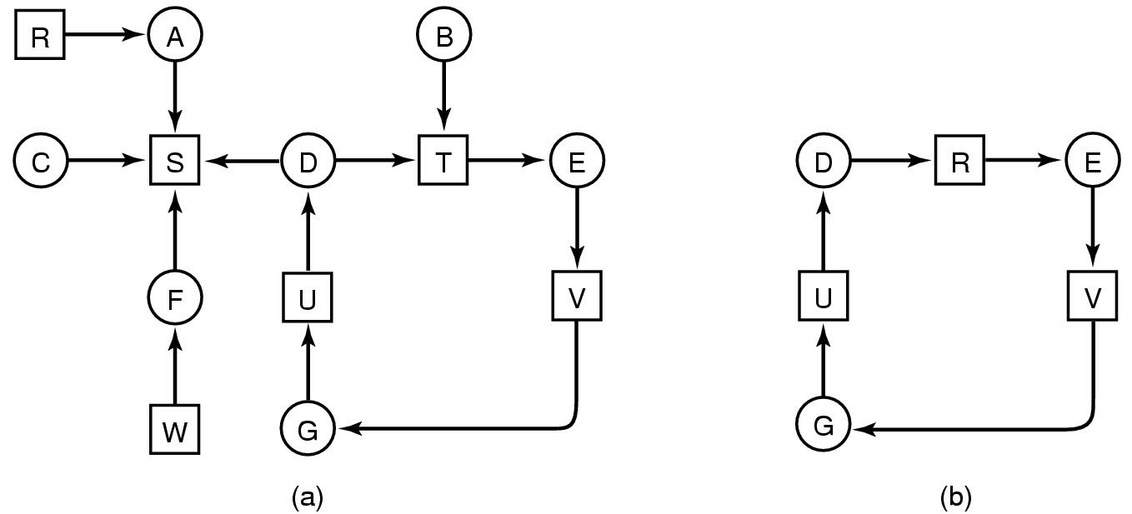
Detection with One Resource of Each Type (1)
T
Note the resource ownership and requests
A cycle can be found within the graph, denoting deadlock

Slide 16
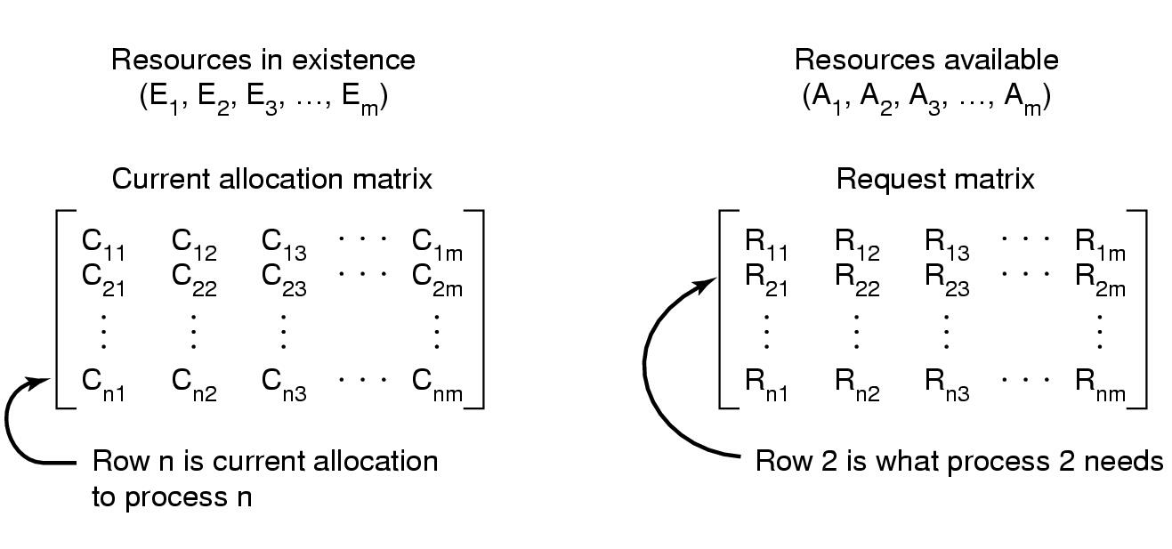
Detection with One Resource of Each Type (2)
Data structures needed by deadlock detection algorithm

Slide 17
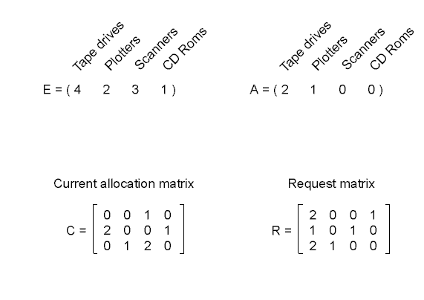
Detection with One Resource of Each Type (3)
A=E-C
+ C3=0 1 2 0
A= 2 2 2 0
+C2= 2 0 0 1
A = 4 2 2 1
+C1= 0 0 1 0
Ri<=A
לכל תהליך שורה
לוודא שמקבלים בסוף בחזרה את E, בכל שלב מתקיים A+C=E
An example for the deadlock detection algorithm

Slide 18
Recovery from Deadlock (1)
Recovery through preemption
  take a resource from some other process
  depends on nature of the resource
Recovery through rollback
  checkpoint a process periodically
  use this saved state
  restart the process if it is found deadlocked

Slide 19
Recovery from Deadlock (2)
Recovery through killing processes
  crudest but simplest way to break a deadlock
  kill one of the processes in the deadlock cycle
  the other processes get its resources
  choose process that can be rerun from the beginning

Slide 20
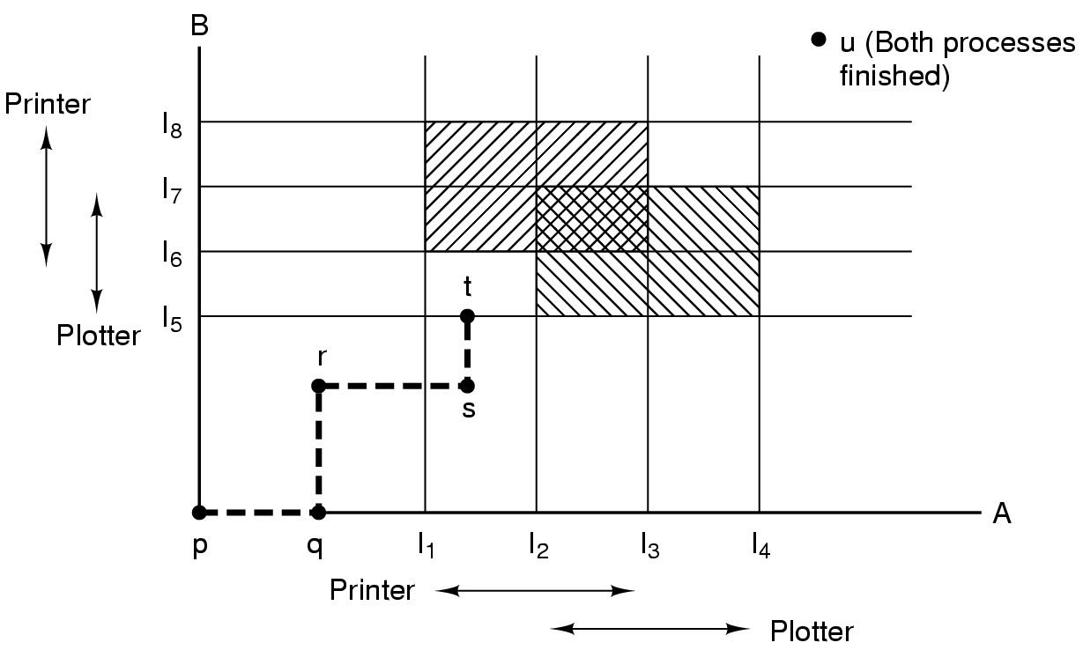
Deadlock Avoidance
Resource Trajectories
Two process resource trajectories

Slide 21
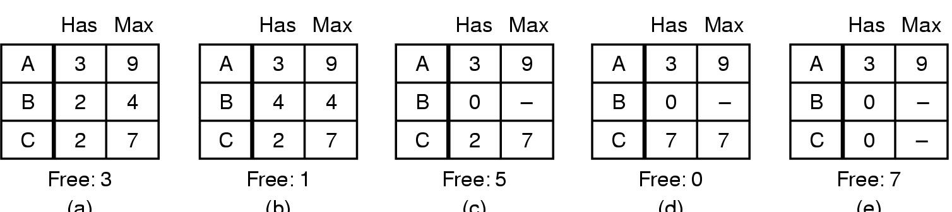
Safe and Unsafe States (1)
E=10
C
R
6
0
0
R
6
2
5
R
6
0
5
A=
+2
A=7
+3
A=10
(a) (b) (c) (d) (e)
+2
A=5
Demonstration that the state in (a) is safe

Slide 22
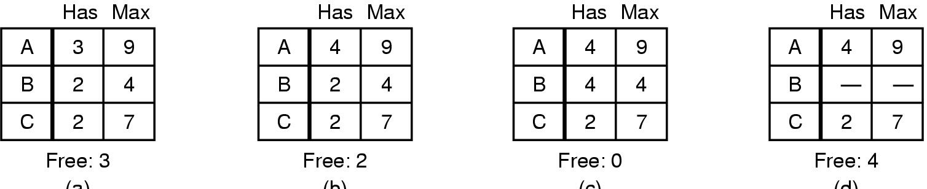
Safe and Unsafe States (2)
A++
R
6
2
5
R
5
2
5
R
5
-
5
(a) (b) (c) (d)
Demonstration that the sate in b is not safe

Slide 23
מצב לא בטוח =! קיפאון?
ייתכן ועברנו את נקודת המקסימום (ואין שוב)
התהליך הרבה לפני המקסימום.
לא נגיע מקסימום משום שזה תלוי קלט (המתכנת הצהיר בזמן קומפילציה)
ייתכן ונשחרר את המשאבים , דהיינו לא עלייה מונוטונית של כל התהליכים

Slide 24
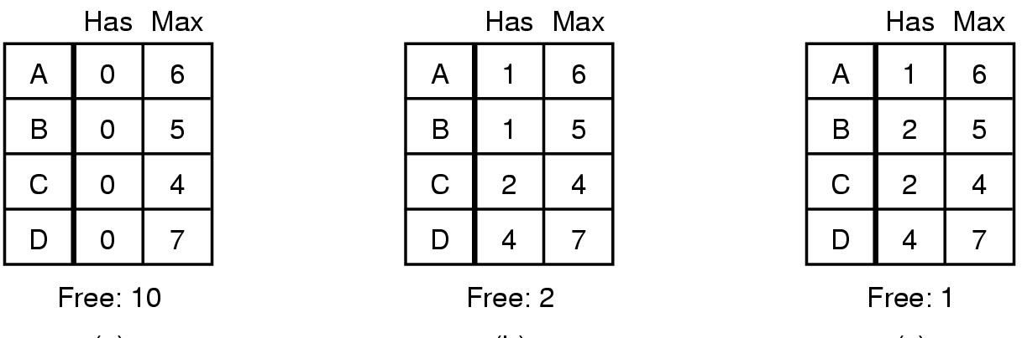
The Banker's Algorithm for a Single Resource
R
5
4
2
3
R
5
3
2
3
A=2
+2
A=4
(a) (b) (c)
+1+4
A=9
+1
A=10
Three resource allocation states
  safe
  safe
  unsafe

Slide 25
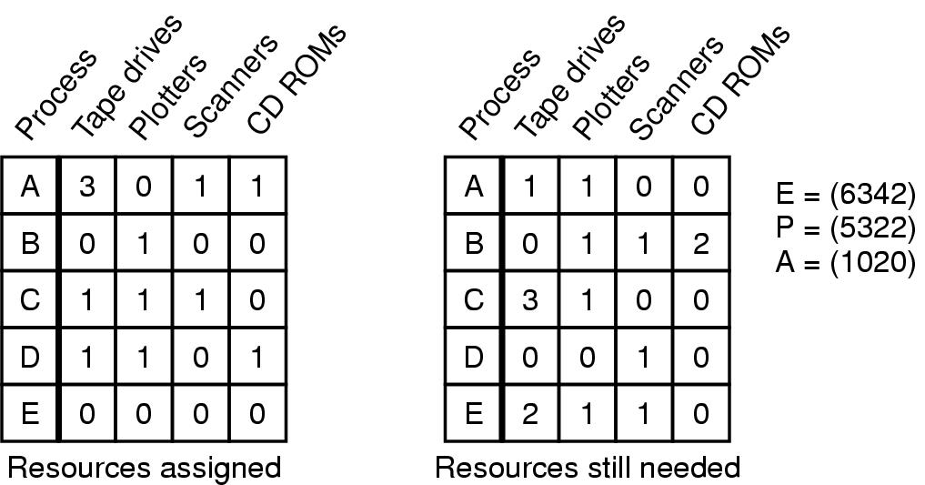
Banker's Algorithm for Multiple Resources
Ri<=A
C=
R=
+ 1101 D
= 2121
+ 3011 A,E
= 5132
+ 0100 B
+1110 C
= 6342
P= 5 3 2 2
Example of banker's algorithm with multiple resources

Slide 26
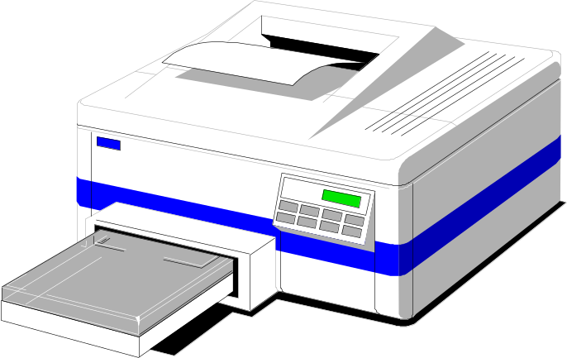
Deadlock Prevention
Attacking the Mutual Exclusion Condition
Some devices (such as printer) can be spooled
  only the printer daemon uses printer resource
  thus deadlock for printer eliminated
Not all devices can be spooled
Principle:
  avoid assigning resource when not absolutely necessary
  as few processes as possible actually claim the resource

Slide 27
Attacking the Hold and Wait Condition
Require processes to request resources before starting
  a process never has to wait for what it needs
Problems
  may not know required resources at start of run
  also ties up resources other processes could be using
Variation:
  process must give up all resources
  then request all immediately needed

Slide 28
Attacking the No Preemption Condition
This is not a viable option
Consider a process given the printer
  halfway through its job
  now forcibly take away printer
  !!??

Slide 29
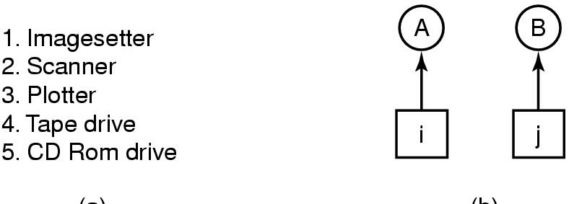
Attacking the Circular Wait Condition (1)
(a) (b)
Normally ordered resources
A resource graph

Slide 30
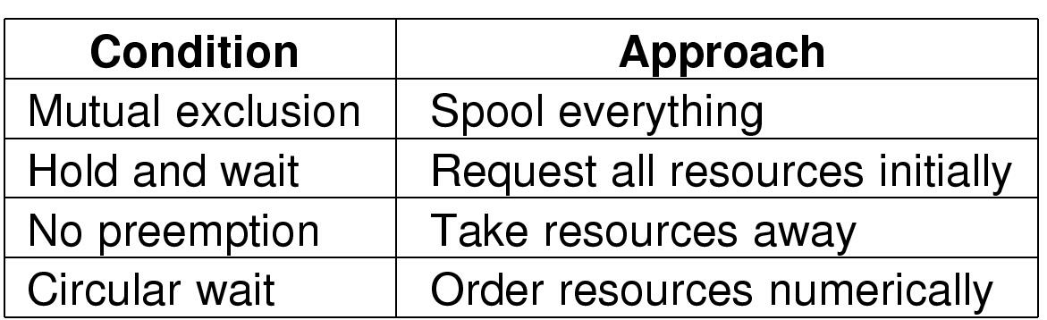
Attacking the Circular Wait Condition (1)
Summary of approaches to deadlock prevention

Slide 31
Other Issues
Two-Phase Locking
Phase One
  process tries to lock all records it needs, one at a time
  if needed record found locked, start over
  (no real work done in phase one)
If phase one succeeds, it starts second phase,
  performing updates
  releasing locks
Note similarity to requesting all resources at once
Algorithm works where programmer can arrange
  program can be stopped, restarted
פרוטוקול זה שקול לדרישה להחזקת כל המשאבים הניתנים לשינוי, מראש. לכן לא יכול לשמש כפתרון כללי לבעיית הקיפאון

Slide 32
Nonresource Deadlocks
Possible for two processes to deadlock
  each is waiting for the other to do some task
Can happen with semaphores
  each process required to do a down() on two semaphores (mutex and another)
  if done in wrong order, deadlock results

Slide 33
Starvation
Algorithm to allocate a resource
  may be to give to shortest job first
Works great for multiple short jobs in a system
May cause long job to be postponed indefinitely
  even though not blocked
Solution:
  First-come, first-serve policy

Slide 34
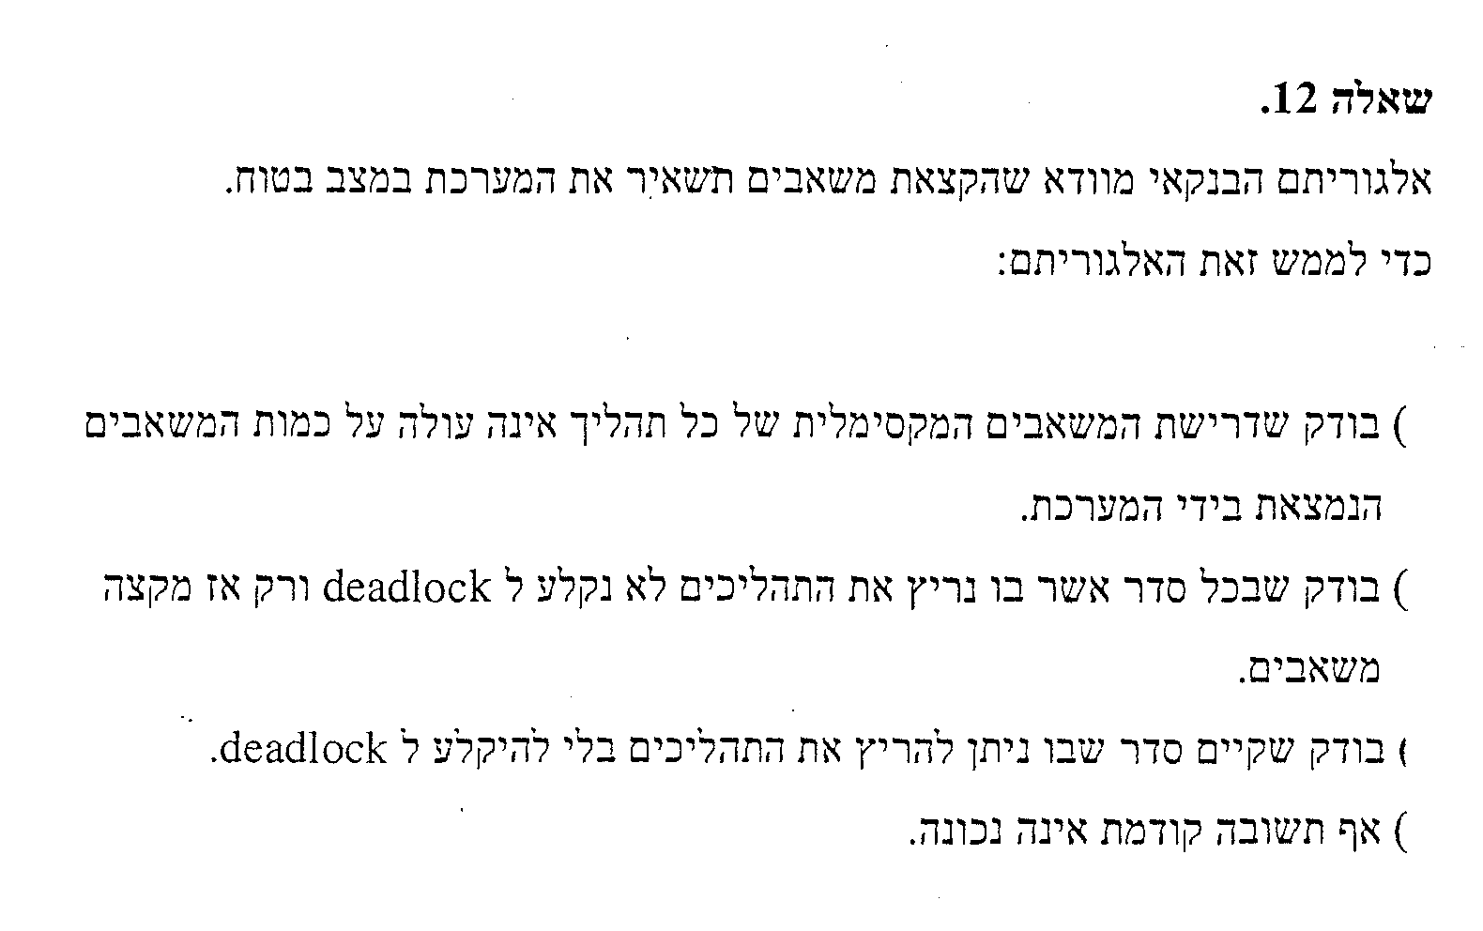
א
ב
ג
ד

Slide 35
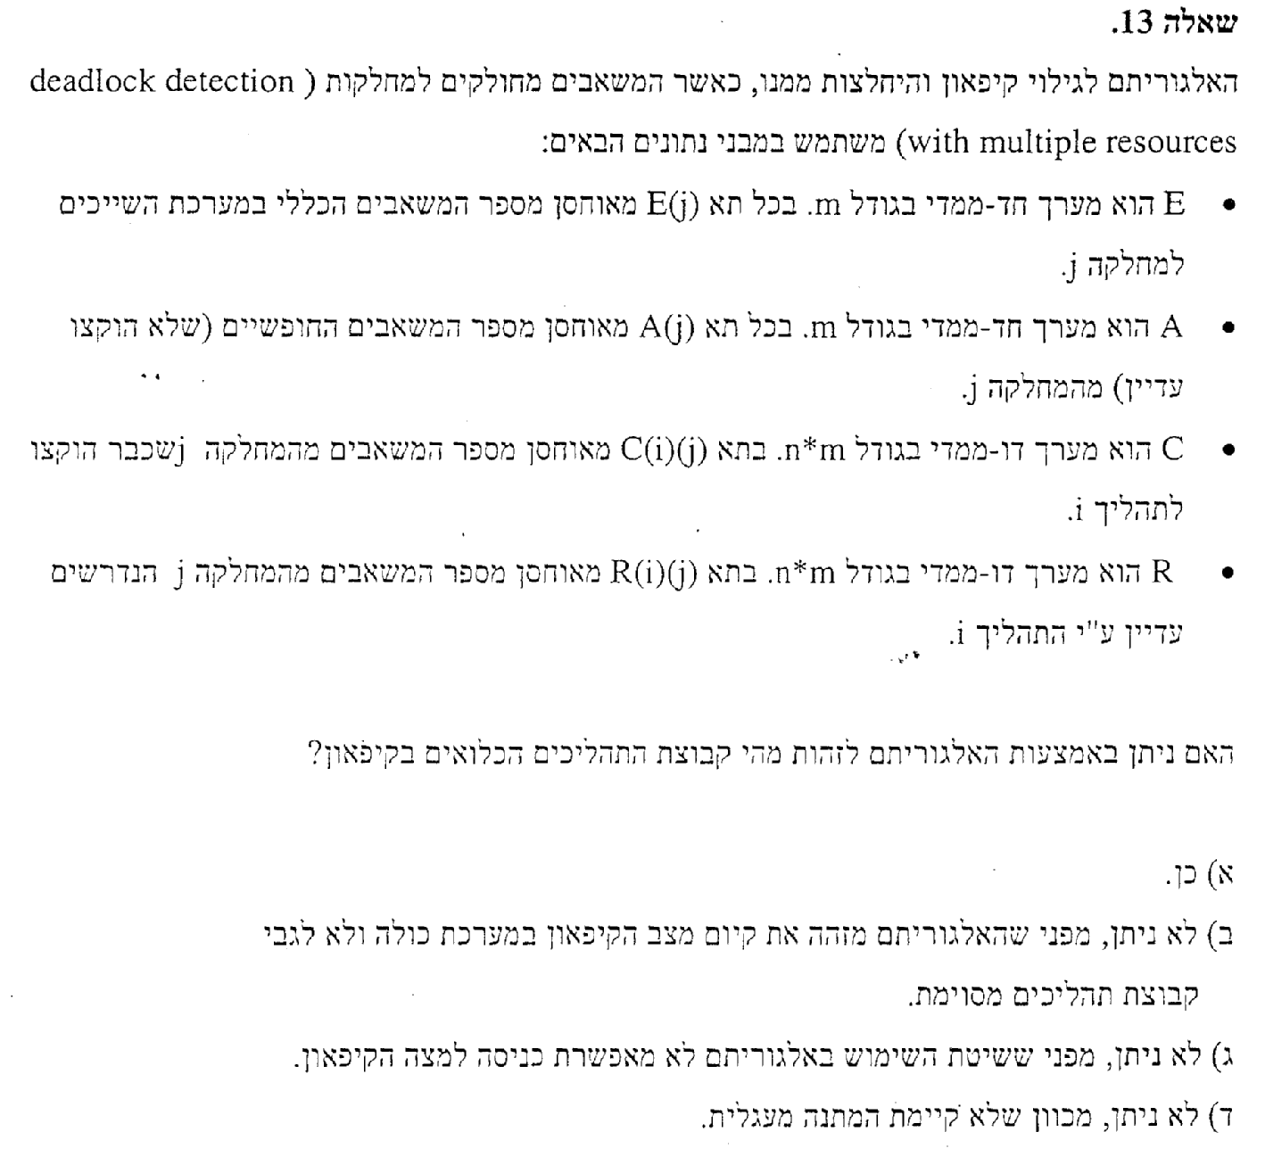

Slide 36
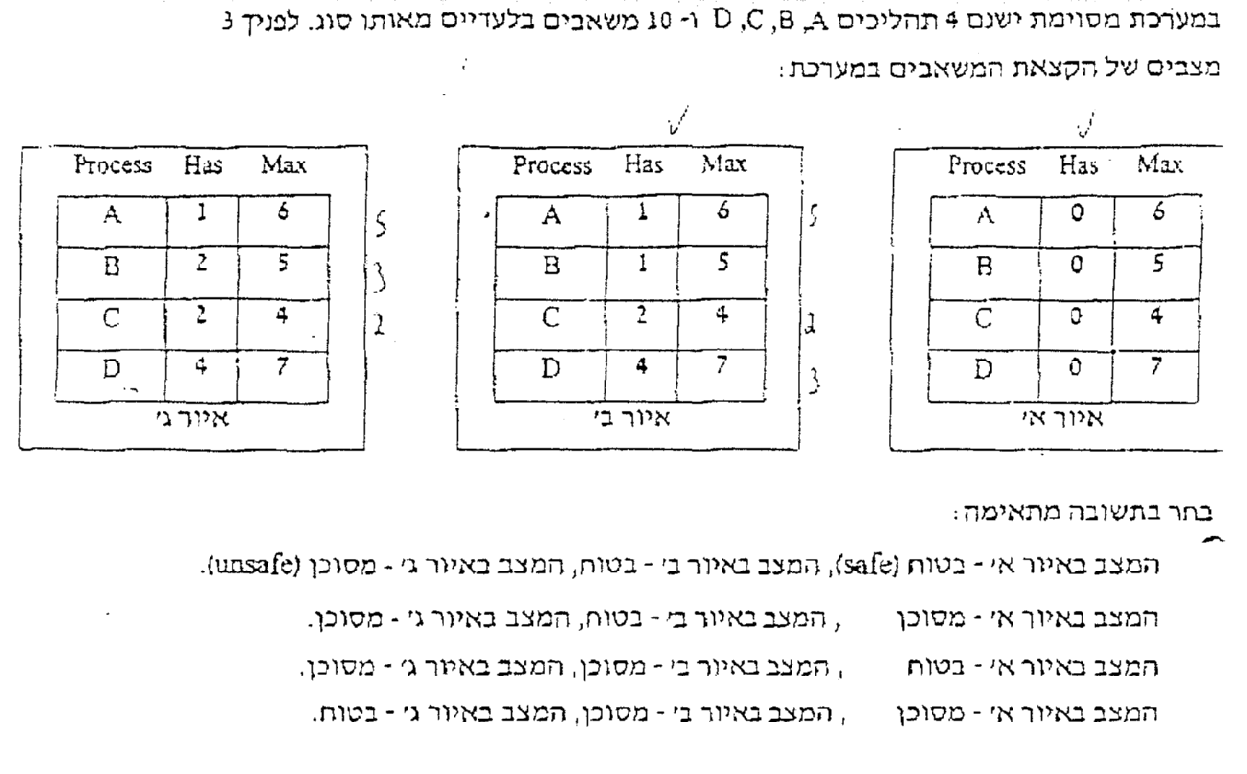

Slide 37
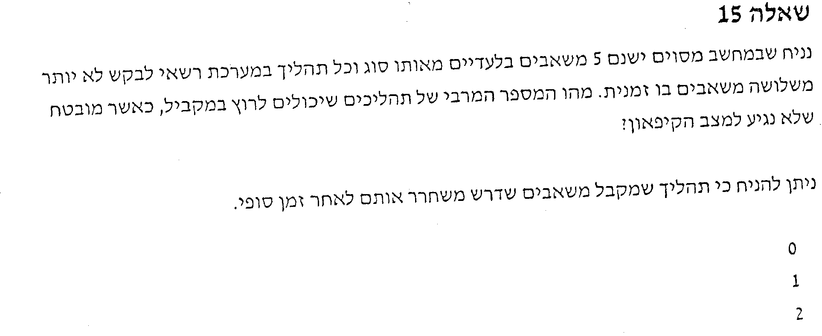
E=5
R | MAX | HAS
1 | 3 | 2 | A
1 | 3 | 2 | B
 |  |  | C
A=1
3
4

Slide 38
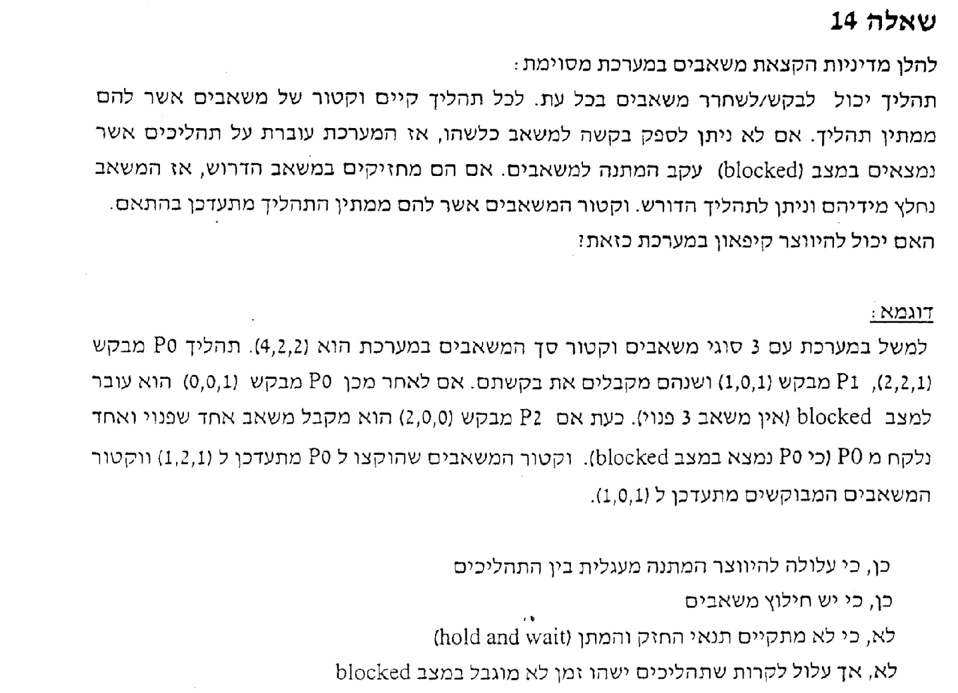
א
ב
ג
ד

Slide 39
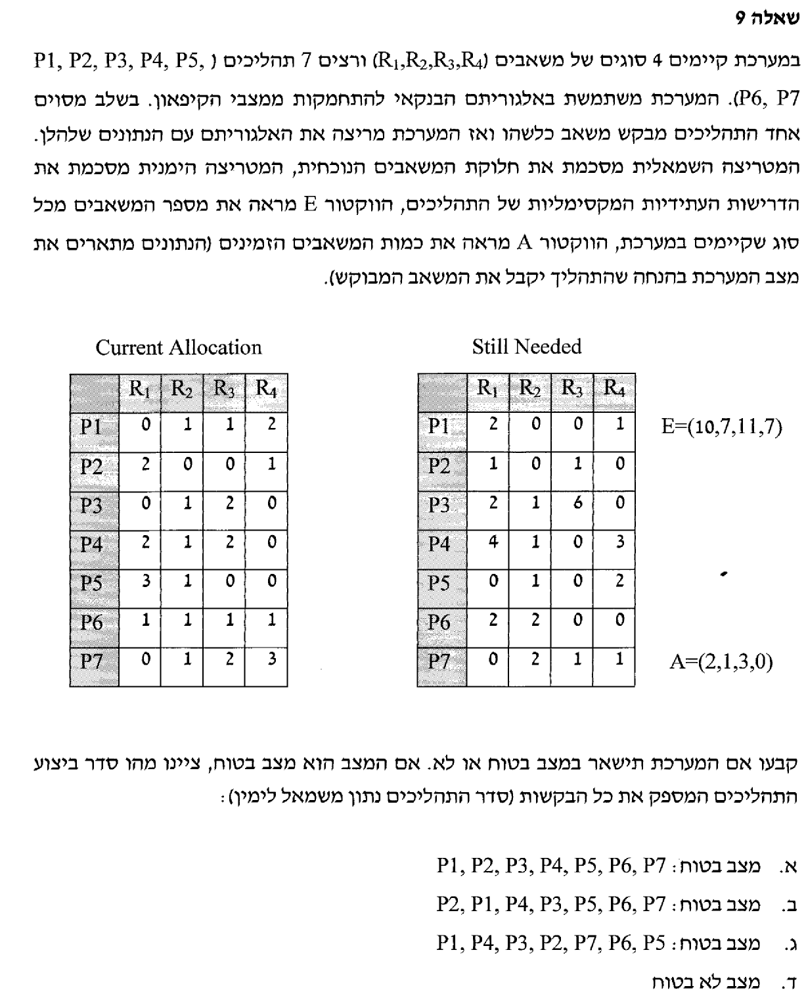
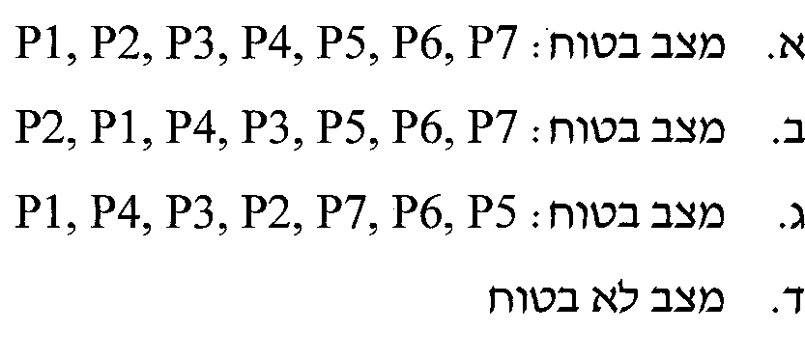
A=(2,1,3,0)
P2=(2,0,0,1)
A=(4,1,3,1)
P1=(0,1,1,2)
A=(4,2,4,3)
P4=(2,1,2,0)
A=(4,3,6,3)
P3,P5,P6,P7

